Slide 1
SEIS 632 PROJECT PRESENTATION
James Magnuson
Simge Okut
Mariyam George Rajeev
Zolboo Tsogbayar

Slide 2
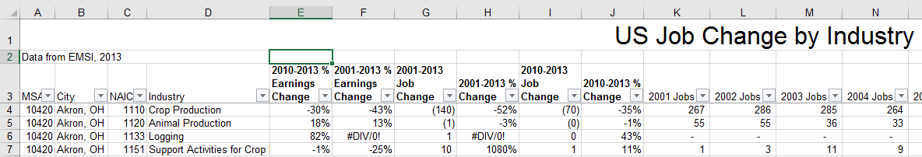
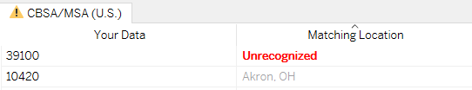
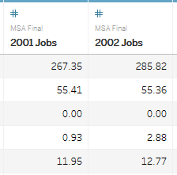
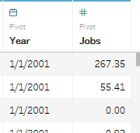
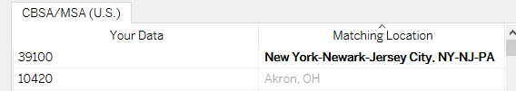
The Dataset – US Job Change by Industry
Shows trends in the US job market from 2001 to 2013
Dataset Changes
Each record had several “jobs by year” columns
Impossible to work with if you want to isolate the actual year
Solution was to Pivot the columns
MSA 39100 no longer exists according to the US Census
39100 was for Poughkeepsie, NY
Solution was to match 39100 to NYC-Newark

Slide 3
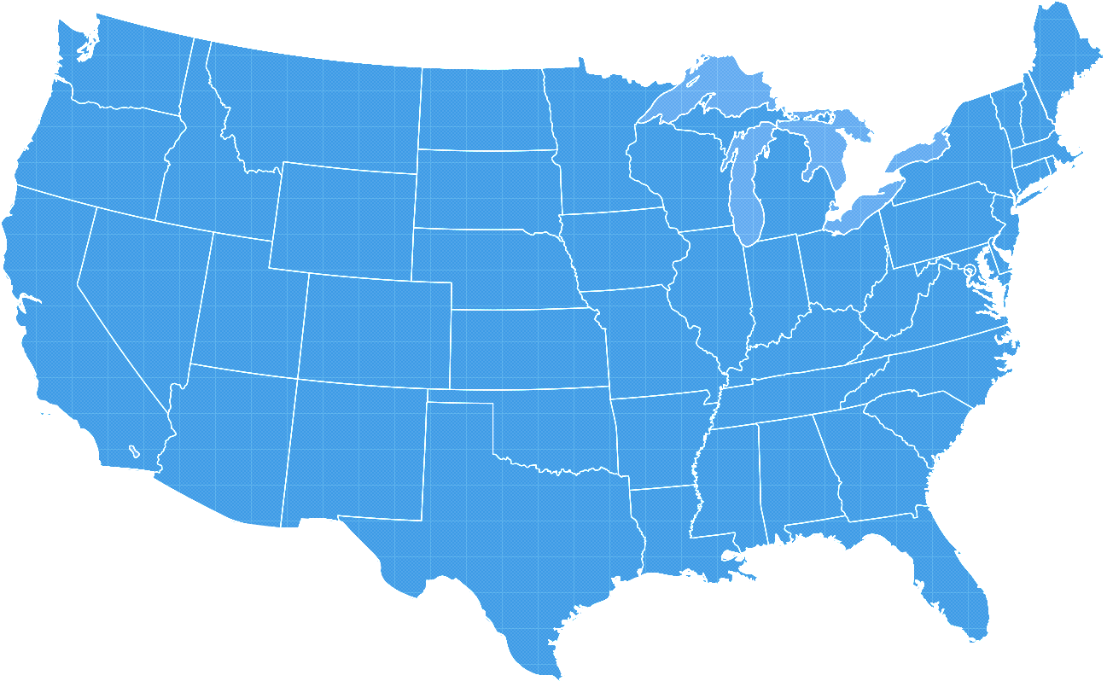
The Story
General trends in the US job market from 2001 to 2013
Drill down to look at a city we’re all familiar with

